Slide 1
Comparative analysis of outlier detection approaches over cloud computing Published International Journal on Computer Science and Engineering (IJCSE) july 2017
Uğur Ceylan

Slide 2
Content
Introduction
Type of Outliers
Various Outliers Detection
Application of Outliers
Difficulties in Outlier Detection
Comparative Analysis

Slide 3
I. INTRODUCTION
Data mining: The progression of mine some useful information, pattern, knowledge which is formerly unidentified and identifiable information from the huge dataset and taking it for used in organizational decision making [1]
However, there is lots of issues in mining of data is substantial dataset such as data redundancy, unavailability of data or difficult access to data, the worth of trail elements is not precise
The exist facts object that do not comply with general behavior of data which is defines as outlier
The identification of outlier accord beneficial, ample and significant perception and number of applications area such as climatology, ecology public health, transportation and location based services, intrusion detection, mobile phone and assurance privilege fraud recognition and industrial damage detection.

Slide 4
II. TYPES OF OUTLIERS
A. Point(global) Outlier : An independent fact instance can be reflected an unusual with respect to the respite of facts, then the instance is labelled as a point outlier
Example, we consider credit card transaction with dataset corresponding to a single credit card transaction inferring data definition by amount exhausted. A transaction for which the amount spent is actual extraordinary related to the regular range of the regular range of disbursement for that person will be point outlier
B. Collective outlier: When related datasets collection is compare to the entire instance, than it is well-defined as a collection outlier.

Slide 5
II. TYPES OF OUTLIERS – Cont..
C. Contextual(conditional) outlier: When a dataset is irregular through respect to certain context, then it is also as conditional outlier. The belief of a context is indeed of by the structure in the dataset and has to be contemplate as a fragment of the problem formulation. Each facts instance is define using two sets of attribute:
Contextual attributes : are defined as the positions, latitude and longitude in spatial dataset and in timeseries data, a contextual attributes
Behavioral attributes: This is well define as the quantity of rainfall at a particular place, when stated about the middling rainfall of the whole planet within the domain of geospatial data.

Slide 6
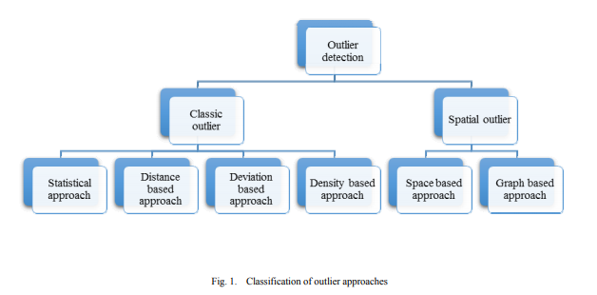
III. VARIOUS OUTLIER DETECTION

Slide 7
III. VARIOUS OUTLIER DETECTION – Cont..
A. Classic Outlier: This type of outlier based on operational dataset which is collection of numbers of items. A typical case is “market basket data”, in which every transaction is considered as the cluster of items asset by the user in operation. Such information can also be amplified by auxiliary item relate the customer or the context of transaction. As a result, mostly outlier are used for research on trading data.
1. Statistical based approach : The oldest procedure which have been used for outlier identification, which a model coined as distribution model for give dataset and using a divergent test they detect outlier.
2. Distance based approach : Regular data items have more dense neighborhood, outlier are for away each other i.e. has a less dense neighborhood and has been.
3. Deviation based approach: In deviation based method [9] given a set of information point outlier are point that do not fit to the general feature of that set.
4. Density based approach : This approach evaluate the density distribution of the data and find the outlier which are in low-density territory.

Slide 8
III. VARIOUS OUTLIER DETECTION – Cont..
B. Spatial Outlier : Spatial dataset could be labeled as a reference objects of cluster of spatially.
1. Space based approach: This approach apply Euclidian distance for selecting spatial neighborhoods.
2. Graph based approach: This approach is mostly used to related graph connectivity to describe spatial neighborhoods.
3. Cluster based approach: This outlier detection approach is relatively effective as the data from the datasets is initially segmented into clusters. In every cluster each data point is authorized as a degree of the membership. The outlier is discovered without any interference in the clustering process. Numerous clustering approaches are used for the outlier detection. k-means, PAM, CLARA and CLARANS..

Slide 9
IV. APPLICATION OF OUTLIER DETECTION
A. Fraud Detection: In outlier techniques are useful for detection in credit card duplicitous application and credit card duplicitous usage.
B. Insider Fraud Detection: Within data may be unusual types, generally denotes to any of the data that can influence the cost of stock in a given manufacturing pending legislation affecting an exacting industry.
C. Intrusion Detection: Outlier detection techniques help into find out the suspicious different types of transaction in government department i.e. IT department.
D. Industrial Damage Detection: Industrial unit suffer damage due to regular usual wear and tear . This kind of damages need to be detected early to prevent further rise and losses. The information in this field is generally sensor recorded data by means of various sensor and composed for investigation.
E. Therapeutic and Community Health Outlier Detection: In such scenarios, for identifying outlier the method used in grouped outlier detection. Numerous methods also focused on identifying diseases in a definite locale

Slide 10
V. DIFFICULTIES IN OUTLIER DETECTION
In numerous zones regular activity keeps growing and might not be present to be an agent further.
Conflicting concept of outlier in diverse applicable make it complex to relate method formed in a single arena to the other.
Imprecise margin between common in addition to outlier performance at a deviation of outlier examination line near to the edge could really be regular and vice-versa.
Approachability of labeled information for instruction of models which are being worn by outlier detection methods.
Honk in the information which tends in relation to the outlier of original nature, this is why it complicated in differentiate and eliminate.

Slide 11
VI. COMPARITIVE ANALYSIS
As many of outlier detection approaches are available for detecting an outliers and the usage of all these vary according to which kind of data is being used, size of the dataset etc. [27]. Now with the remarkable progress of data, best outlier detection approach have to be applied on large data sets [28]. So the elementary parameters like efficiency, computational cost, scalability and applicability needs to be studied.
A. Efficiency : It is well-defined as the estimation of the average execution time needed for an approach to complete work on a particular data set. Efficiency of a process is measured by its order. It is helpful for quantifying implementation difficulties of definite problems.

Slide 12
VI. COMPARITIVE ANALYSIS – Cont..
B. Computational Complexity : It is directly comparative to the computational complexity of the approach. It is the estimation of the number of steps required by the approach associated for input of an instance or a given size in the worst case. Functional size is estimated by the various steps.
C. Scalability : It is defined as the ability of the product or a computer application to continue to function well even when it is altered in size or volume, according to the user needs. It is basically a rescaling like expandability of an application platform which can be used on larger operating systems for handling large number of users and also for better performance.
D. Applicability : As each approach has its boundaries and limits set for being applicable on any given set of data. Depending upon the data set i.e. whether it is a statistical data or large dataset, various approaches are applied on the datasets to detect outliers

Slide 13
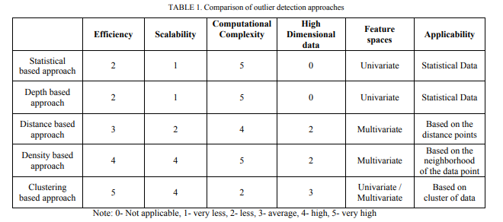
VI. COMPARITIVE ANALYSIS – Cont..
All the above stated outlier detection approaches are compared in table-1 with respect to certain parameters like efficiency, computational cost, scalability, applicability and high dimensional data etc.

Slide 14
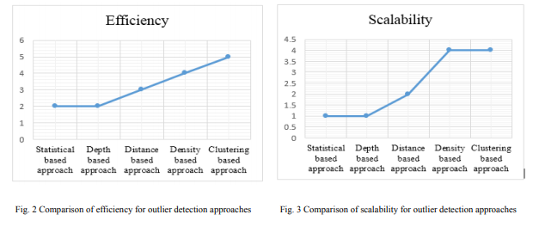
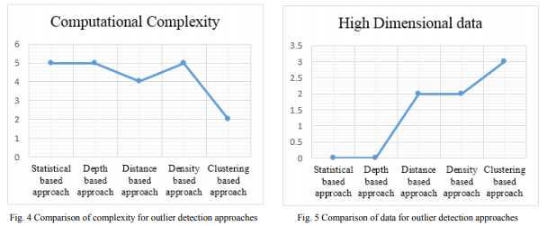
VII. RESULT COMPARISION
The above graphs in fig.2-5 is designed by evaluating, analyzed and compared in the table1 which show the variation in terms of efficiency, high dimensional data, scalability, feature space, computational complexity and applicability for all outlier detection approaches on huge datasets.

Slide 15
VII. RESULT COMPARISION – Cont..
In fig. 2, efficiency statistical outlier detection approach and depth outlier detection approach are less efficient with respect of other three approaches in which clustering outlier approach is highly efficient outlier detection approach. From fig. 3, The comparative graph show that the statistical outlier detection approach, depth outlier detection approach and distance outlier detection approach are less scalable with compare to other two approach which is density outlier detection approach and clustering outlier detection approach which are high in scalability. And the last parameter i.e. computational complexity, clustering outlier approach is best approach because it has low complexity, highly scalable and highly efficient which is shows in fig. 4. And in terms of high dimensional data the fig. 5 reflected that statistical based approach and depth based approach have very low dimensionality in term of data whereas clustering based approach has high dimensionality in terms of data. The comparative analysis reflect that clustering outlier detection approach is optimized for large datasets.

